Slide 1
Midterm (and final) review MSC 407 Fall 2012
Brian Mapes

Slide 2
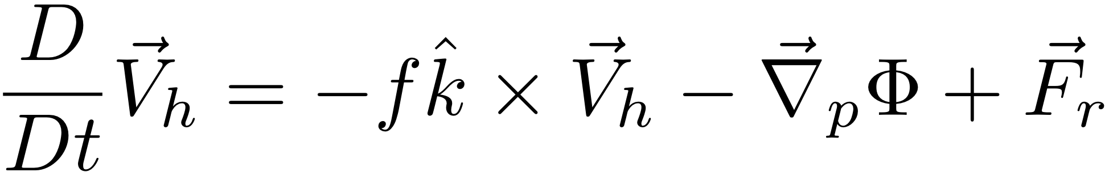
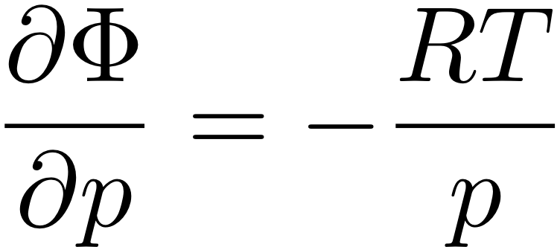
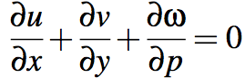
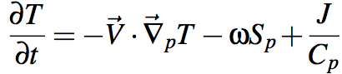
“The Primitive Equations”
(meaning elemental, fundamental)
F=ma in the HORIZONTAL (in p coords)
HYDROSTATIC (w/ ideal gas law to eliminate ρ)
MASS CONSERVATION
FIRST LAW OF THERMO
Notes:
\frac{D}{Dt} \vec V_h = -f \hat k \times \vec V_h - \vec \nabla_p \phi +\vec F_r
\frac {\partial \Phi}{\partial p} = - \alpha \equiv -\frac{1}{\rho}
\alpha = \frac{RT}{p}
\frac {\partial u}{\partial x} + \frac {\partial v}{\partial y} + \frac {\partial \omega}{\partial p} = 0
\frac {D_hT}{Dt} + S_p \omega = J/C_p

Slide 3
About all the equations
Review

Slide 4
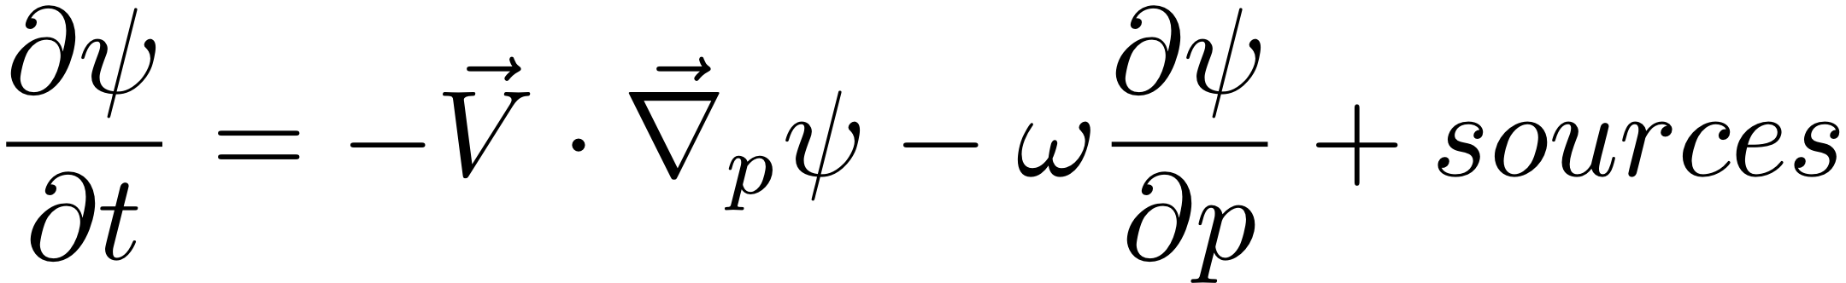
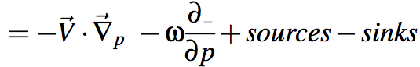
Advection: from the chain rule Here ψ means any quantity (T, u, v, ...)
Lagrangian (total) time derivative
Dψ/Dt = dψ/dt = source terms (or sources minus sinks)
The rate of change of an air parcel’s value of ψ
Eulerian: Local rate of change of ψ at a point
∂ψ/∂t = sum of all tendencies = advection + source terms
Chain rule:
D/Dt( ψ(x,y,p,t) ) = ∂ψ/∂t + ∂ψ/∂x•(Dx/Dt) + ∂ψ/∂y•(Dy/Dt) ...
D/Dt( ψ(x,y,p,t) ) = ∂ψ/∂t + ∂ψ/∂x •( u ) + ∂ψ/∂y• ( v ) ...
Advection eq: vector form in horizontal, p coordinate in vertical

Slide 5
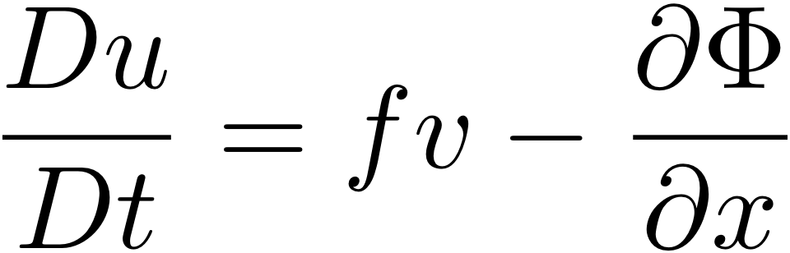
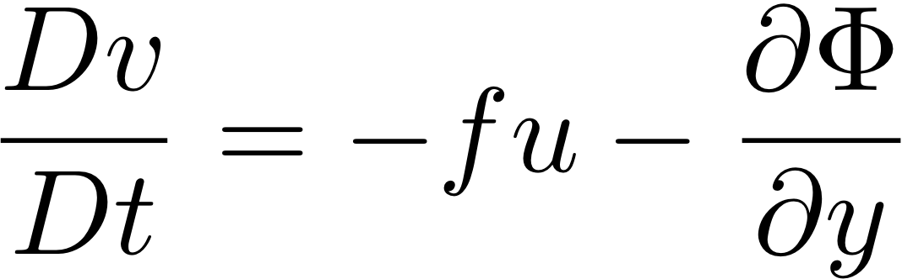
The horizontal momentum equations
The u and v momentum equations in pressure coordinates are:
The u momentum equation:
The v momentum equation:
Notes:
\frac {Du}{Dt} = fv - \frac {\partial \Phi}{\partial x}
\frac {Dv}{Dt} = -fu - \frac {\partial \Phi}{\partial y} \frac {Dv}{Dt} = -fu - \frac {\partial \Phi}{\partial y}

Slide 6
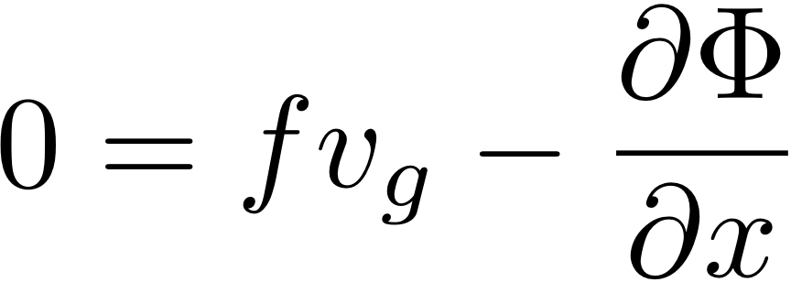
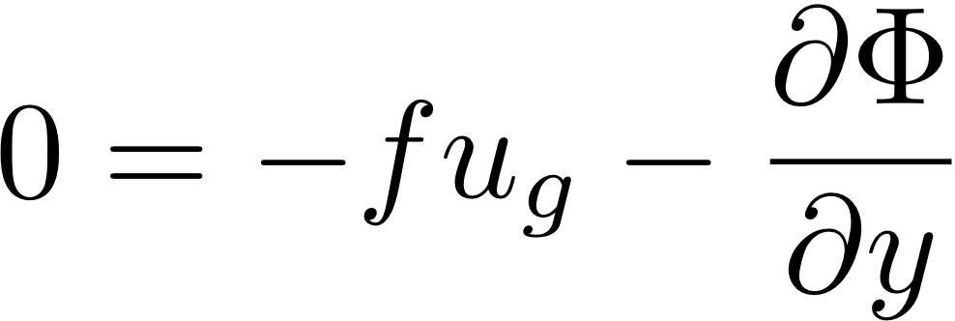
Geostrophic wind
The geostrophic wind is defined as the wind {u_{g},v_{g}} which makes the LHS equal to zero.
That is, the Coriolis force acting on the geostrophic wind would exactly balance the PGF term.
The u momentum equation:
The v momentum equation:
Notes:
\frac {\partial u_g}{\partial x}+\frac {\partial v_g}{\partial y} \simeq 0

Slide 7

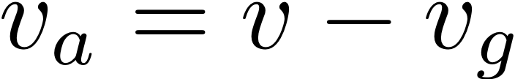
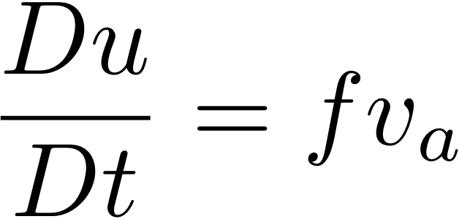
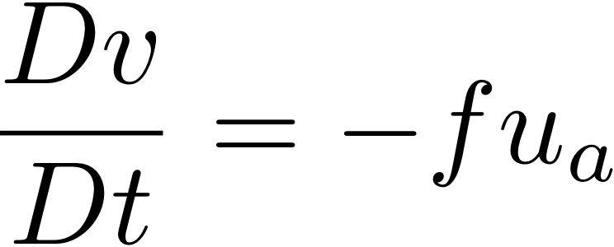
The ageostrophic wind
The ageostrophic wind is defined as the difference between the actual wind and the geostrophic wind:
3. Substitute (u_{g}+u_{a}) for u and (v_{g}+v_{a}) for v in the momentum equations above to show that the following are true:
Notes:
\frac {Du}{Dt} = fv_a
\frac {Dv}{Dt} = -fu_a

Slide 8
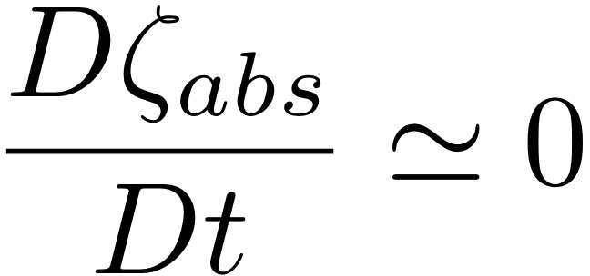
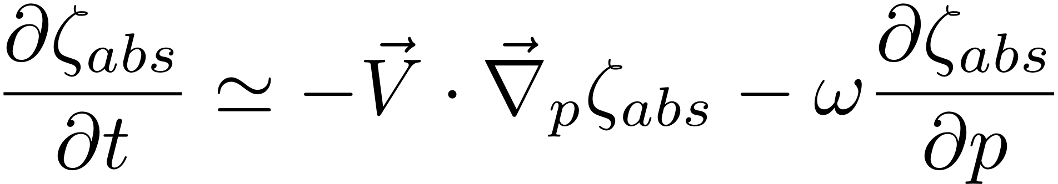
Vorticity key points
Relative vorticity patches "induce" winds around them that weaken with range, proportional to (1/distance).
Absolute vorticity is almost conserved, just advected like smoke, especially at 500mb where the bartotropic vorticity equation (BVE) is a pretty good approximation:
The combination of 1. and 2. means vorticity-induced winds in turn advect (move) the contours of vorticity. This interaction loop is one reason why long range weather forecasting is hard.
Same eqn.
(BVE) →
Notes:
\frac {D\zeta_{abs}} {Dt} \simeq 0
\frac {\partial \zeta_{abs}} {\partial t} \simeq -\vec V \cdot \vec \nabla_p \zeta_{abs} - \omega \frac {\partial \zeta_{abs}} {\partial p}

Slide 9
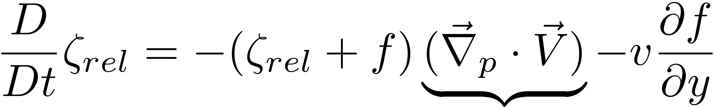
Absolute and relative vorticity
absolute = (relative + planetary):
ζ_{abs}= ζ_{rel} + ζ_{plan}
planetary vorticity ζ_{plan} = f
(aka the “Coriolis parameter”)
f = 2Ω cos(φ)
Ω = (2π radians)/(1 day)
At 40N, f = 10⁻⁴ s⁻¹
A more complete vorticity equation:
The Beta Effect (Rossby waves)
This term is called "vortex tube stretching"
Divergence

Slide 10
Review of key parts of Part I (and MSC 405)
0. Advection (the chain rule): Understand D/Dt and ∂/∂t
The geostrophic approximation (u_{g} and v_{g})
ageostrophic wind is small, but has important aspects
u_{a} and v_{a} includes the divergence (tied to vertical motion)
DV/Dt = f(V_{a} x k) (controls how the flow changes w/ time)
Vorticity (∂v/∂x - ∂u/∂y):
absolute vorticity is almost conserved (just advected around)
relative vorticity "induces" tangential winds α 1/(distance)
vortices advecting other vortices is a lot of what weather is
Potential temperature: conserved for adiabatic flow
Potential vorticity: more conserved than vorticity
like circulation: vorticity times area. Unchanged by divergence.

Slide 11
Strategic/hungry reading of the equations
1. About how a warm core vortex forms “from scratch”
2. About how we can get omega which we desire from a coupled set of equations

Slide 12
The atmosphere moves because of
heating / cooling
F=MA in the HORIZONTAL
HYDROSTATIC (w/ ideal gas law to eliminate ρ)
MASS CONSERVATION
FIRST LAW OF THERMO
J makes it go!
Notes:
\frac{D}{Dt} \vec V_h = -f \hat k \times \vec V_h - \vec \nabla_p \phi +\vec F_r
\frac {\partial \Phi}{\partial p} = - \alpha \equiv -\frac{1}{\rho}
\alpha = \frac{RT}{p}
\frac {\partial u}{\partial x} + \frac {\partial v}{\partial y} + \frac {\partial \omega}{\partial p} = 0
\frac {D_hT}{Dt} + S_p \omega = J/C_p

Slide 13
Heating and cooling driven flows
Low latitude: local latent heat release (rain)
leads to warm core vortices (like hurricanes...)
Poles: cold in winter
leads to planetary scale cool core “polar vortex”
Instability in midlatitudes
tentacles stretch or even break off polar vortex
Midlatitude storms have clouds & rain too
but as a secondary effect...
ahead of troughs... why?

Slide 14
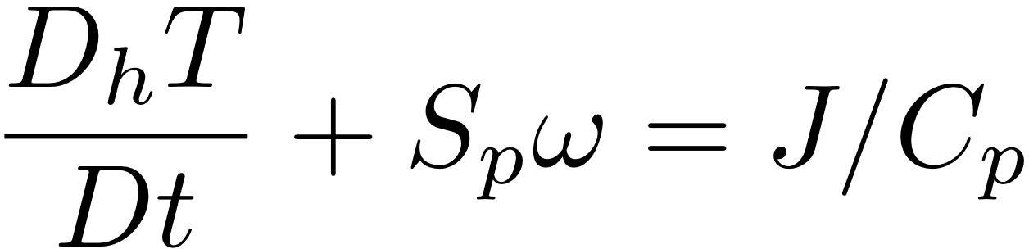
The Primitive Equations show how a local heating J drives flow in an initially motionless atmosphere
J causes T to increase
net change of T =
amount of heat added/Cp
2. Warmer T causes increased thickness of the heated column
3. High Φ over hot column pushes wind outward
4. Surface pressure drops (remember, omega = Dp/Dt; Holton eq. 3.44)
Notes:
Homework 5, MSC 405. Due Thursday, April 13
This problem set walks through the heated-air-rising process above, for a 100 km patch of latent heating in an initially motionless atmosphere.
ALL ANSWERS MUST HAVE UNITS, BUT NUMBERS CAN BE SIMPLE ROUGH ESTIMATES.
Suppose the heating J corresponds to the latent heat released during 1cm of rain over a 100km x 100km area. Let’s figure out how much ΔT that causes.
What is the volume of water condensed (m³)?
What is the mass of water condensed (kg)?
How much latent heat is released (Joules)? (L = 2.5 x 10⁶ J per kg of water).
How many kg of air are in a 1 square meter column of atmosphere, if surface pressure p is 1000mb? M=p/g
How many kg of air are therefore in a 100km x 100km column?
If Cp = 1000 J/(kg K), by how many K can the heat from c. warm the air mass from e.?

Slide 15
HW: use The Primitive Equations to compute how a local heating J drives flow in an initially motionless atmosphere
5. Low Φ under hot column pulls wind inward
6. Hot air rises (finally!)
ω =~ ρgw
7. Coriolis force turns inflowing and outflowing air to make round-and-round flow
Notes:
Homework 5, MSC 405. Due Thursday, April 12
This problem set walks through the sequential process above, for a 100 km patch of latent heating in an initially motionless atmosphere.
ALL ANSWERS MUST HAVE UNITS, BUT NUMBERS SHOULD BE ROUGH: 1-2 SIGNIFICANT DIGITS.
Suppose the heating J corresponds to the latent heat released during 1cm of rain over a 100km x 100km area. Let’s figure out how much ΔT that causes.
What is the volume of water condensed (m³)? (1 point)
What is the mass of water condensed (kg)? (1 point)
How much latent heat is released (Joules)? (1pt) (L = 2.5 x 10⁶ J per kg of water).
How many kg of air are in a 1 square meter column of atmosphere, if surface pressure p is 1000mb? M=p/g (1)
How many kg of air are therefore in a 100km x 100km column? (1)
If Cp = 1000 J/(kg K), by how many K can the heat from c. warm the air mass from e.? (1)

Slide 16
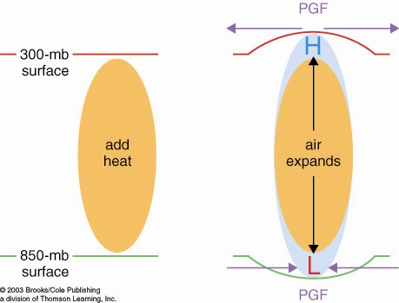
How heated air rises and a warm core vortex develops: the Primitive Equation view. 7 logical steps
1. Warmed column of air gets thicker
2. Air accelerates
due to PGF
2. Air accelerates
due to PGF
1. 200 mb
surface
bulges
upward
0. Heating (maybe latent heating by condensation in a patch
of convection over warm water someplace)

Slide 17
How heated air rises and a warm core vortex develops: the Primitive Equation view. 7 logical steps
3. Mass removal and 4. surface pressure drop
3. Mass removed
from column
3. Mass removed
from column
4. less mass of air in column
= lower surface pressure
L

Slide 18
How heated air rises and a warm core vortex develops: the Primitive Equation view. 7 logical steps
5. Low level inflow accelerates, 6. heated air rises
6. warm
air
rises!
(continuity)
5. Air accelerates
due to PGF
5. Air accelerates
due to PGF

Slide 19
How heated air rises and a warm core vortex develops: the Primitive Equation view. 7 logical steps
ANTI
CYCLONIC
Warm Core
Vortex
in thermal wind
balance
CYCLONIC
FLOW
7. Coriolis turns flow to right

Slide 20
Strategic/hungry reading of the equations
1. About how a warm core vortex forms “from scratch”
2. About how we can get at omega (which we desire) from a tangled-up, coupled set of equations for several variables

Slide 21
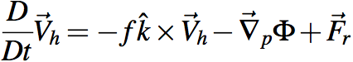
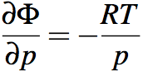
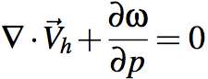
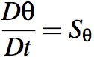
Holy grail of dynamics: get ω, the key to clouds and rain using... The Primitive Equations
HORIZONTAL MOMENTUM CONSERVATION
HYDROSTATIC
(from vertical momentum conservation law)
MASS CONSERVATION
=0 for adiabatic flow
THERMODYNAMIC ENERGY CONSERVATION
Notes:
\frac{D}{Dt} \vec V_h = -f \hat k \times \vec V_h - \vec \nabla_p \Phi +\vec F_r
\frac {\partial \Phi}{\partial p} = - \alpha \equiv -\frac{1}{\rho}
\alpha = \frac{RT}{p}
\frac {\partial u}{\partial x} + \frac {\partial v}{\partial y} + \frac {\partial \omega}{\partial p} = 0
\nabla \cdot \vec V_h + \frac {\partial \omega}{\partial p} = 0
\frac {D \theta}{Dt} = S_{\theta}

Slide 22
The atmosphere is thin, so a lot of its flow is horizontal large scale circulations. Can’t we study the dynamics of that without getting sucked into thermodynamics?
If only we could clobber the “gradient of Φ” term...
F=MA in the HORIZONTAL
HYDROSTATIC (w/ ideal gas law)
MASS CONSERVATION
FIRST LAW OF THERMO
Notes:
\frac{D}{Dt} \vec V_h = -f \hat k \times \vec V_h - \vec \nabla_p \phi +\vec F_r
\frac {\partial \Phi}{\partial p} = - \alpha \equiv -\frac{1}{\rho}
\alpha = \frac{RT}{p}
\frac {\partial u}{\partial x} + \frac {\partial v}{\partial y} + \frac {\partial \omega}{\partial p} = 0
\frac {D_hT}{Dt} + S_p \omega = J/C_p

Slide 23
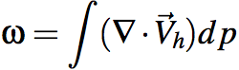
Holy grail of dynamics: get ω
There it is! Grab it!
Yeah I took Calc 1
Oops, it's hooked to wind
uhh, ... this could take awhile
Simplify life: "inviscid", air is soooo slippery.
2. The Coriolis force (f term) is conceptually simple once you know it
NOTE: "k x" is pronounced "90 degrees to the left of"
Notes:
\omega = \int (\nabla \cdot \vec V_h) dp
\frac{D}{Dt} \vec V_h = -f \hat k \times \vec V_h - \vec \nabla_p \Phi +\vec F_r
\frac {\partial \Phi}{\partial p} = - \alpha \equiv -\frac{1}{\rho}
\alpha = \frac{RT}{p}
\frac {\partial u}{\partial x} + \frac {\partial v}{\partial y} + \frac {\partial \omega}{\partial p} = 0
\frac {D \theta}{Dt} = S_{\theta}

Slide 24
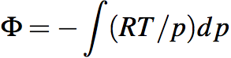
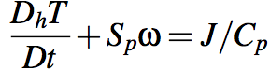
Holy grail of dynamics: get ω
Straightforward, gimme Φ − grab from hydrostatic eq’n:
Uh-oh, now we need T
OR
Uh-oh, now we need ω, and condensation heating (clouds and rain)... we need the grail to get the grail! Dead end!
Notes:
\Phi = - \int (RT/p) dp

Slide 25
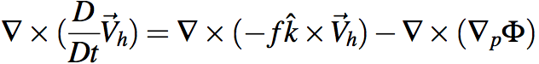
Holy grail of dynamics: get ω
Gotta avoid dragging thermo into this via Φ.
Get rid of Φ at any cost. Curl to the rescue!
Ker-CHING!
We are Masters of the Universe with our sexy vector identities!
The grail is in the bag!
Notes:
\nabla \times (\frac{D}{Dt} \vec V_h) = \nabla \times (-f \hat k \times \vec V_h) - \nabla \times (\nabla_p \Phi)

Slide 26
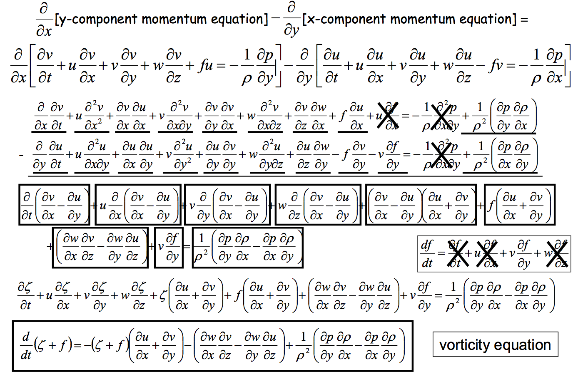
Heh heh ... did I say "any cost"... ? gulp
Can we scrape back some of these cobwebs?
Wait a sec, what's this??

Slide 27
A glimpse of gold
Zero on a p surface
Inconvenient*
Yesssss
*and can be shown to be small if δx and δy are very large and w is very small.
We’ll settle for a large-scale grail.

Slide 28
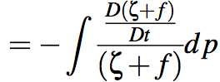
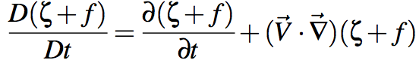
Holy grail of dynamics: get ω
Formally, success! But, do we have all the parts?
Simplify: steady state. Watch a weather loop sometime: the wind blows through the pattern, but the pattern itself (large scales, remember) is quasi-stationary.
Notes:
\omega = \int (\nabla \cdot \vec V_h) dp
= -\int \frac {\frac{D(\zeta + f)}{Dt}} {(\zeta + f)} dp
\frac{D(\zeta + f)}{Dt}} = \frac{\partial(\zeta + f)}{\partial t}} + (\vec V \cdot \vec \nabla)(\zeta + f)

Slide 29
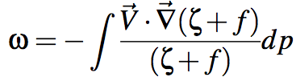
Holy grail of dynamics: get ω
OK, we need a wind field, as a function of p.
(A vorticity field at each level can be calculated from that, trivially).
Back to the wind equation, but with renewed hope
Notes:
\omega = -\int \frac {(\vec V \cdot \vec \nabla)(\zeta + f)} {(\zeta + f)} dp
\frac{D(\zeta + f)}{Dt}} = \frac{\partial(\zeta + f)}{\partial t}} + (\vec V \cdot \vec \nabla)(\zeta + f)
\frac{D}{Dt} \vec V_h = -f \hat k \times \vec V_h - \vec \nabla_p \Phi +\vec F_r

Slide 30
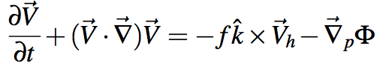
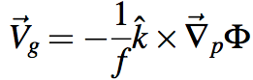
Holy grail of dynamics: get ω
Gimme an equation for wind.
Less is more, and we’ve already settled for steady state…
Oh yeah: balanced winds. Familiar! And we’re already limited to large scales, so skip the ‘gradient wind’ fanciness and just use the good ol’ GEOSTROPHIC WIND
(remember, k × just means ‘90 degrees to the left of’ )
Notes:
\frac{\partial\vec V}{\partial t}} + (\vec V \cdot \vec \nabla)\vec V = -f \hat k \times \vec V_h - \vec \nabla_p \Phi

Slide 31
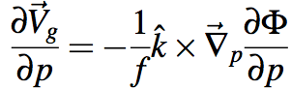
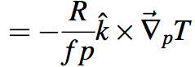
Holy grail of dynamics: get ω
And we need wind as a function of p
So remember the THERMAL WIND
Drum roll please…
Given Φ at some p, with its horiz. gradients
Have geostrophic wind
And given a T field with horizontal gradients
Have geostrophic wind at all heights
Compute ζ, advect (ζ+f), and you’ve got ω!
Notes:
\frac{\partial\vec V}{\partial t}} + (\vec V \cdot \vec \nabla)\vec V = -f \hat k \times \vec V_h - \vec \nabla_p \Phi
\frac {\partial \vec V_g}{\partial p} = - \frac{1}{f} \hat k \times \vec \nabla_p \frac{\partial \Phi}{\partial p}
= - \frac{R}{fp} \hat k \times \vec \nabla_p T

Slide 32
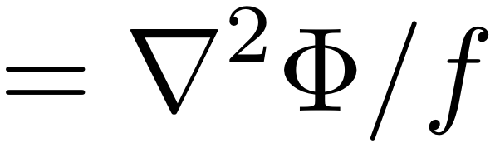
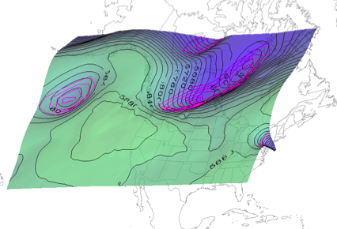
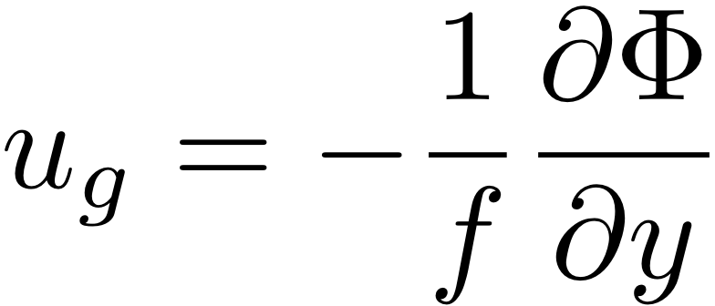
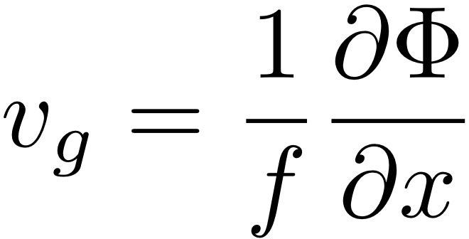
Geostrophic vortices and the Z field (height depressions of a p surface)
The geostrophic relative vorticity is:
ζ_{g} = (∂v_{g}/∂x - ∂u_{g}/∂y) = g/f (∂²Z/∂x² + ∂²Z/∂y²⁾
Geostrophic vorticity is the
←Curvature of the Z or Φ field
Notes:
\frac {D\zeta_{abs}} {Dt} \simeq 0
\frac {\partial \zeta_{abs}} {\partial t} \simeq -\vec V \cdot \vec \nabla_p \zeta_{abs} - \omega \frac {\partial \zeta_{abs}} {\partial p}

Slide 33
The thermal wind
It is a geostrophic wind difference
(upper minus lower level)
example for 850-500mb layer: V_{T} = V_{g500}-V_{g850}
The thermal wind points along isotherms
with Low values to the Left of the vector in the NH
The thermal wind cannot advect isotherms!
because it is parallel to them
Warm air advection (WAA): veering
geostrophic wind turns clockwise w/ height (in NH)
CAA: backing of wind with height

Slide 34
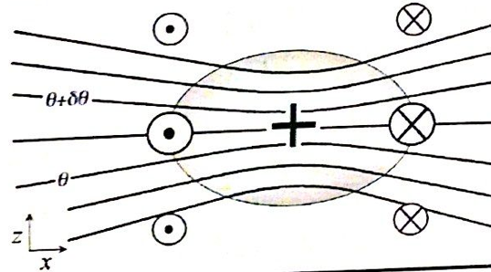
Geostrophic and hydrostatic balance
Every cyclonic vortex obeying both hydrostatic and geostrophic balance looks similar to this (but maybe stretched or shrunk or partly cut off by the Earth's surface):
PV > 0

Slide 35
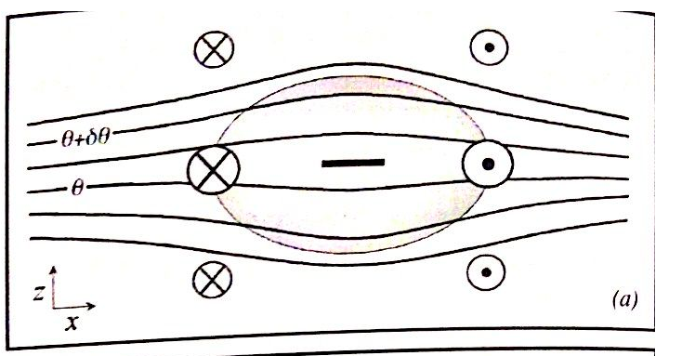
And anticyclones exist too...
Just the opposite of a cyclone...
PV < 0

Slide 36
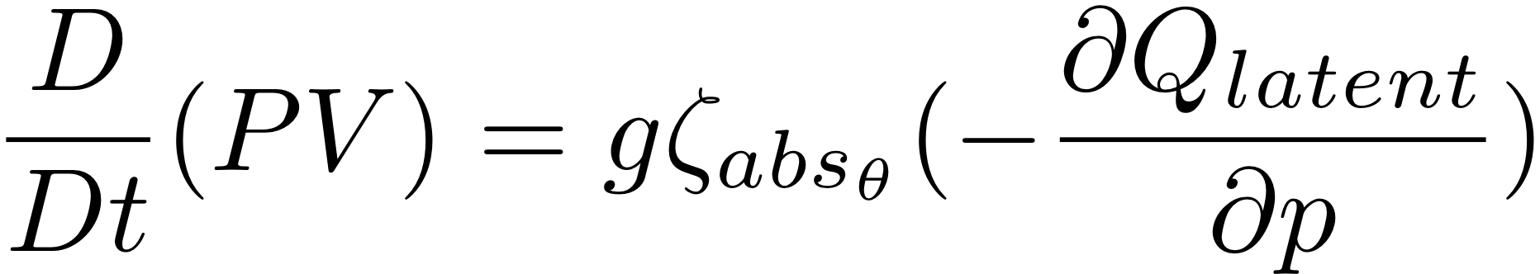
Potential vorticity and the two kinds of balanced cyclones
2. We will see that midlatitude (cool core) cyclones are the bottom half of tentacles or pieces of the upper-level Polar Vortex of PV. These tentacles reach into middle latitudes, and induce flow down in the troposphere.
3. We will see that tropical cyclones (warm core cyclones) are the top half of a PV vortex which was created at the base of the latent heating in rainstorms according to:

Slide 37
Sample questions for midterm
3 parts
Part 1: language and primitive equations
Part 2: elementary math results
Part 3: image interpretation (maps and cross sections)

Slide 38
Sample Question part 1
a) Write down the primitive equations in any form you like. Make it perfect! All or nothing! And Part c depends on it! (a theta form for the First Law may be simpler than the T form)
b) Put a grid around the terms like in the following slide.
c) Identify which equations or terms represent or contain: radiative heating, advection of momentum, the concept of thickness, conservation of mass, the PGF, etc. etc.

Slide 39
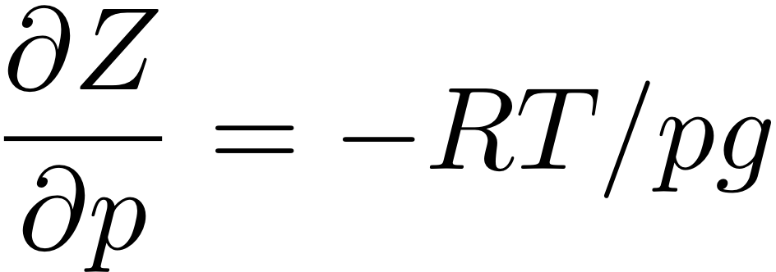
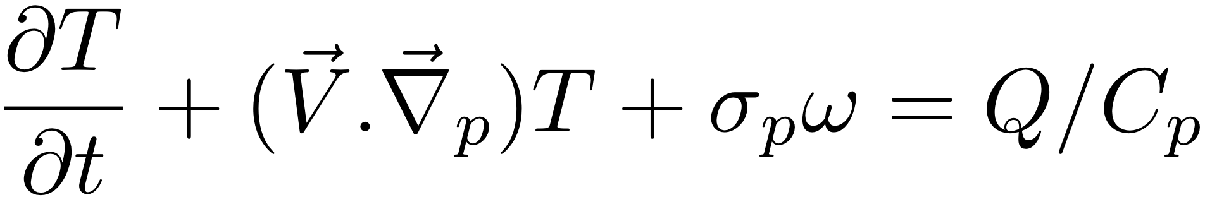
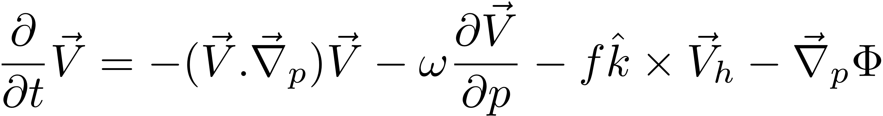
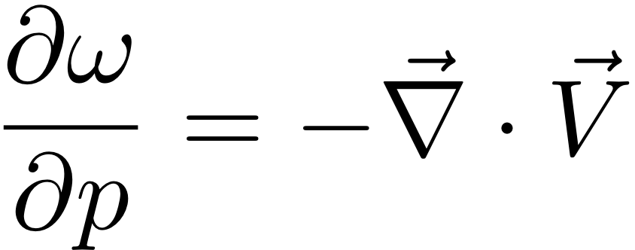
MSC 405 Final 2011
Name___________
Here is the primitive equation set for hydrostatic flow using pressure p as the vertical coordinate. Vector V is horizontal wind and ∇_{p} is the horizontal gradient operator with its derivatives evaluated at constant p.
A
B
C
D
E
1
2
3
4
Notes:
\frac{\partial}{\partial t} \vec V = -(\vec V.\vec \nabla_p) \vec V -\omega \frac{\partial \vec V}{\partial p}+f \hat k \times \vec V_h - \vec \nabla_p \Phi
\frac {\partial \omega}{\partial p} = -\frac {\partial u}{\partial x} - \frac {\partial v}{\partial y}
\frac {\partial T}{\partial t} + (\vec V.\vec \nabla_p)T + \sigma_p \omega = Q/C_p
\frac {\partial \Phi}{\partial p} = -RT/p

Slide 40
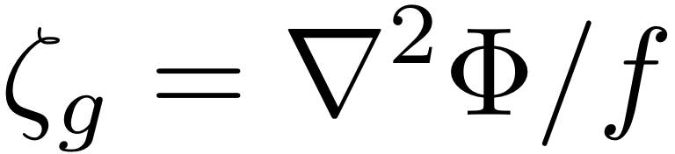
Sample Questions Part 2
Show that
Explain why we are especially interested in the ageostrophic part of the wind, even though it is smaller than the geopstrophic part.
Show that
Explain what this means about the relationship between vorticity and height fields

Slide 41
Sample questions Part 2
Why does tangential wind decay away proportional to 1/distance from a patch of relative vorticity? Hint: understand Gauss's Theorem (from wikipedia or wherever)
Show using the Chain Rule for d/dt( T(x,y,t) ) that advective tendencies are MINUS THE PRODUCT OF VELOCITY AND THE GRADIENT OF T.

Slide 42
Sample questions Part 3
Given a map of V_{g500} and V_{g850} vectors,
Find areas of WAA and CAA (veering and backing)
Sketch thermal wind vectors V_{T,500-850}
Sketch isotherms (parallel to V_{T} vectors)
Given cross sections through cold core (upper level) and warm core (low level) cyclones, can you identify contours of p, T, theta, and PV? Can you draw some given the others? Can you indicate the winds (arrows in/out of the page)?

Slide 43
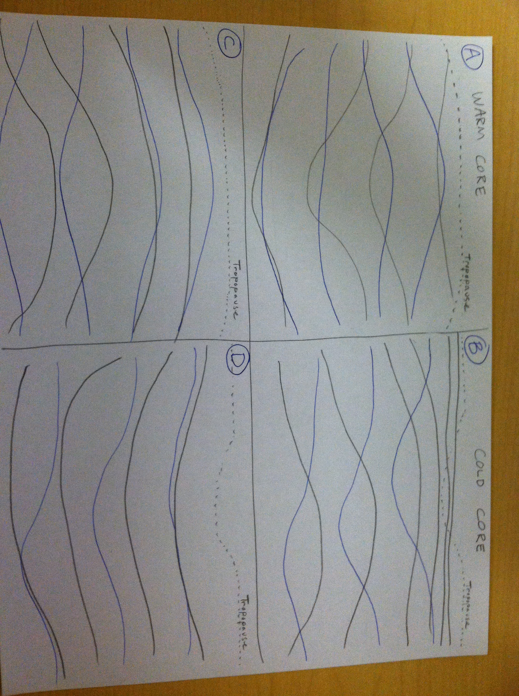
Sample question Part 3
a) Label which contours are T, p, and theta in these x-z cross sections of cold and warm core cyclones:
b) Indicate the winds in & out of the page with symbols like this. Make sure to use size to indicate what levels have stronger vs. weaker winds. (for Northern hemisphere)

Slide 45
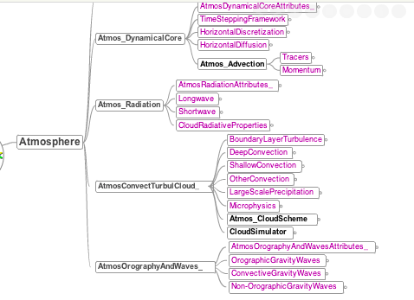
Mind map – what is an atm. model?
http://metafortrac.badc.rl.ac.uk/trac/browser/controlled_vocabularies/trunk/Software/Atmosphere_bdl.mm

Slide 46
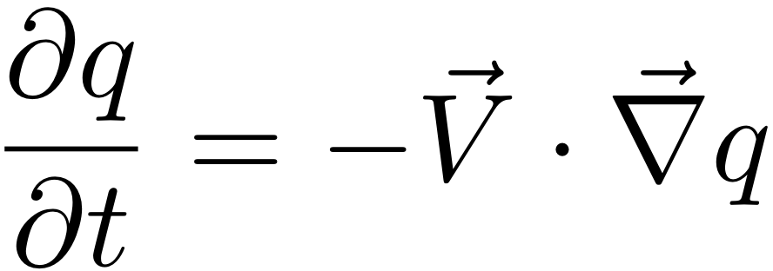
Advection: principles and issues
The Lagrangian or total-derivative conservation problem Dq/Dt = 0 can be written as an advection problem:
The time integration of the left side, and the space derivatives needed for the right side, can be computed in many different ways:
on different grids, or spectral
with different approximations
These different choices matter for the solutions

Slide 47
Advection trade-offs
There are compromises in every model's set of numerical approximations.
Main issues for the compromise are:
Computational speed or cost
Accuracy
Does it blow up (instability)?
Not an issue here -- nobody accepts instability
Does it violate global conservation of q?
Not something you can see by eye easily
Does it cause unrealistic fluctuations?
Does it cause excessive smoothing?

Slide 48
We will focus on these worries
Does it cause unrealistic fluctuations?
zigzags or stripes, possibly including negative values (violations of monotonicity)
Does it cause excessive smoothing?
weakening maxima/minima by smearing them out
We want to know if these numerical errors might affect the simulations of weather we care about.

Slide 49
Lab 8 – physics tendencies
MSC 407 spring 2012
Name________________

Slide 50
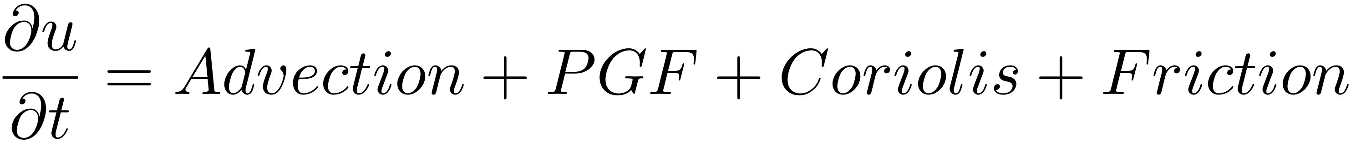

Background: Physical processes (tendencies) in numerical models
Prognostic equations for u and T have terms on the right ("tendencies") which reflect physical processes (Friction F and Heating Q).
(There are also physical and chemical process tendencies on water vapor mixing ratio, on other chemical concentrations, etc.)

Slide 51
List of physical tendencies in one model's thermodynamic equation:
dtdtrad
temperature tendency from radiation
shortwave (solar), longwave (IR)
upwelling, downwelling streams of energy flux
dtdtmst
temperature tendency from moist physics (cond/evap, freez/melt)
dtdttrb
temperature tendency from turbulence (sensible heat flux from surface, deposited throughout the boundary layer by turbulent flux convergence)
dtdtfri
temperature tendency from frictional heating
very small, the wind's KE is << thermodynamic energies
dtdtdyn
temperature tendency from dynamics
large-scale temperature advection and adiabatic warming/cooling with w

Slide 52
Assimilation Key Points
MSC 407 Final Exam Review

Slide 53
Fundamental DA assumption
The fundamental assumption of data assimilation in NWP models is that the model’s short range forecast is reasonably accurate

Slide 54
Why use a model forecast to create the initial conditions for the next forecast?
a short-range forecast is assumed to make a good background for the analysis since it came from a good model;
it retains information from older observations;
it allows the analysis to combine observations of different parameters, sources, and quality by providing a comparison point for quality control and weighting of those observations;
it can provide information that would otherwise be unavailable between observations, based in part on the inclusion and movement of information from previous observations;
the forecast model fields contain dynamical and physical consistencies;
the forecast model fields contain numerical consistencies required for the model to make the next good forecast.

Slide 55
When should a forecaster trust a NWP model less? Why?
Observed weather features too small for the model to properly resolve are left out of the analysis.
The system works best for the most common situations, but extreme or rapidly changing situations may not be handled well in the analysis.
Because these are precisely the situations in which the model initial conditions are likely to be poor and the forecast unreliable…
the forecaster's challenge is to recognize potentially extreme or rapidly evolving weather events and place less emphasis on NWP guidance in developing a forecast.

Slide 56
Sources of Error in Data Assimilation
Data voids in an observing network can cause a model analysis to miss important unpredicted small-scale features.
Data voids in an observing network can cause a model analysis to retain incorrectly predicted small-scale features.

Slide 57
Correctly applying observations
A model may produce a better forecast if its analysis does not fit an accurate observation too closely because… 1) a good model forecast requires an initial condition nearly in balance with the model's imperfect dynamics and physics. 2) the observation may represent features smaller than the model can resolve.

Slide 58

An Introduction to Ensemble Data Assimilation
Jeffrey Anderson, Nancy Collins, Tim Hoar,
Hui Liu, Glen Romine, Kevin Raeder
NCAR Institute for Math Applied to Geophysics

Slide 59



What is Data Assimilation?
Observations combined with a Model forecast…
+
=
… to produce an analysis.
Overview article of DART:
Anderson, Jeffrey, T. Hoar, K. Raeder, H. Liu, N. Collins, R. Torn, A. Arellano, 2009: The Data Assimilation Research Testbed: A Community Facility.
Bull. Amer. Meteor. Soc., 90, 1283–1296. doi:10.1175/2009BAMS2618.1
CAHMDA-V July 2012 pg 59

Slide 60

Ensemble Filter for Large Geophysical Models
1. Use model to advance ensemble (3 members here) to time at which next observation becomes available.
Ensemble state estimate after using previous observation (analysis)
Ensemble state at time of next observation (prior)
CAHMDA-V July 2012 pg 60

Slide 61

Ensemble Filter for Large Geophysical Models
2. Get prior ensemble sample of observation, y = h(x), by applying forward operator h to each ensemble member.
Theory: observations from instruments with uncorrelated errors can be done sequentially.
CAHMDA-V July 2012 pg 61

Slide 62

Ensemble Filter for Large Geophysical Models
3. Get observed value and observational error distribution from observing system.
CAHMDA-V July 2012 pg 62

Slide 63

Ensemble Filter for Large Geophysical Models
4. Find the increments for the prior observation ensemble (this is a scalar problem for uncorrelated observation errors).
Note: Difference between various ensemble filters is primarily in observation increment calculation.
CAHMDA-V July 2012 pg 63

Slide 64

Ensemble Filter for Large Geophysical Models
5. Use ensemble samples of y and each state variable to linearly regress observation increments onto state variable increments.
Theory: impact of observation increments on each state variable can be handled independently!
CAHMDA-V July 2012 pg 64

Slide 65

Ensemble Filter for Large Geophysical Models
6. When all ensemble members for each state variable are updated, there is a new analysis. Integrate to time of next observation …
CAHMDA-V July 2012 pg 65

Slide 66
Ensemble Filter for Large Geophysical Models
A generic ensemble filter system like DART just needs:
1. A way to make model forecasts;
2. A way to compute forward operators, h.
CAHMDA-V July 2012 pg 66

Slide 67
Creating the initial ensemble of CLM.
Replicate what we have N times.
Use a unique (and different!) realistic DATM for each.
Run them forward for “a long time”.
model time
“spun up”
Getting a proper initial ensemble is an area of active research.
“a long time”
We don’t know how much spread we NEED to capture the uncertainty in the system.
CAHMDA-V July 2012 pg 67
Notes:
The spread in the ensemble is the result of unique atmospheric forcing for each instance/ensemble member.
Once we are spun up, we have our initial ensemble.
This is an area of active research, we don’t know how long it takes to spin up CLM in this fashion.

Slide 68
The ensemble advantage.
You can represent uncertainty.
In a free run,
the ensemble spread frequently grows.
With a good assimilation: ensemble spread ultimately remains stable and small enough to be informative
observation times
CAHMDA-V July 2012 pg 68
Notes:
The spread in the ensemble is the result of unique atmospheric forcing for each instance/ensemble member. Once we are spun up, we have our initial ensemble.
We roll a dice, whatever, to randomly pick an instance and declare it to be the TRUTH.

Slide 69
Atmospheric Reanalysis
O(1 million) atmospheric obs are assimilated every day.
Assimilation uses 80 members of 2º FV CAM forced by a single ocean (Hadley+ NCEP-OI2) and produces a very competitive reanalysis.
1998-2010
4x daily
is free and available. Contact dart@ucar.edu
500 hPa GPH
Feb 17 2003
Contours
5200m:5700m by 100
CAHMDA-V July 2012 pg 69

Slide 70

Geopotential height first guess (colors) and analysis minus first guess (lines) for single pressure observations 1mb greater than first guess
CDAS-SFC
EnsFilt
300 mb
1000 mb
Ensemble filter can extract spatially-varying structures relative to the flow and the previous observational density.

Slide 71


Tri-State Tornado Outbreak of 18 March 1925 (deadliest tornado in U.S. history)
Manual Analysis, courtesy C. Doswell
Ensemble mean from Ensemble Filter
(4 hPa interval, 1010 hPa thick)
The Ensemble Filter analysis did not use any
of the observations in the Manual Analysis.

Slide 72

Range of possibilities for Sea Level Pressure 18 March 1925 18Z using 14 (of 57) members
We can characterize the uncertainty in all fields for every analysis

Slide 73


Analyzed 500 mb Z compared with independent radiosonde obs (1935-1956)
Day-3, Day-5, Day-7
500 mb Z anomaly correlation forecast skill from NCEP and ECMWF (Sept-Oct 2007)
Correlation = 0.97
0.9
0.7
Observed Anomaly
0.5
0.3
N = 7106
Analyzed Anomaly
Day 3 Pattern Correlation September-October 2007
0.96 - 0.97
Median Absolute Error = 22.4 m
Expected Error = 21.5 m*
* Assumes observation error of 20 m
(courtesy S. Bronniman and A. Grant, ETH)
Reanalysis skill is comparable to current Day-3 forecast skill !
Notes:
Analysis fit same as ob error!

Slide 74

You are forecasting, on Oct 25
Load the bundle Sandy_members24_udiff.xidv from Blackboard.
This image shows an ensemble of 6-day model forecasts (valid Oct 30). Contours are (980,970,960,950) hPa for SLP, colored for the different ensemble members. Two are emphasized.

Slide 75


Slide 76


Slide 77
Old school: Quasi-Geostrophic Omega Equation
(vorticity-oriented form)
A B C
Term A: three-dimensional Laplacian of omega
Term B: vertical variation of the geostrophic advection of the absolute geostrophic vorticity
Term C: Laplacian of the geostrophic advection of thickness

Slide 78
Reminder: omega forcings
Where is there upward motion?
Upward motion ~ pos. vort. adv. overhead + warm advection
Increasing vorticity creates a
demand for a cool core here,
to hydrostatically support
the vortex's Trough. Air rises.
Increasing thickness here without anticyclonic vorticity for the Ridge this would create would be out of balance. Air rises to stay cool.

Slide 79

While the bundle loads...
(20) Questions about last 3 slides:
Are the equations given exactly equal?
(σ is static stability)
Explain why aquthors chose to place the signs differently.
What is dΦ/dp equal to? What is its sign?
Why would the author of slide 5 prefer to see minus signs in this construction?

Slide 80



Slide 81



cold front...2

Slide 82


warm front 5 UTC

Slide 83

Frontogenesis: d/dt( )
Diabatic deformation tilting

Slide 84
Summary of Frontogenesis
Frontogenesis / frontolysis changes the horizontal temperature gradient, and thus leads to disruption of thermal wind balance
Ageostrophic frontal circulation acts to restore thermal wind balance, can result in clouds, precipitation

Slide 85


QG Frontogenesis: Qn, omega_n
Thermally direct response in entrance
J e t
Thermally indirect response in exit
Queen Elizabeth II Storm – 400-700 mb thickness (contours), QG omega_n (blue/red), and Qn
Q_{n} Picks out 4-cell jet circulation pattern

Slide 86


Jet Exit Region
Q_{n}
V_{ageo}
Thermally Indirect Circulation
V_{ageo}
North
South

Slide 87

Frontal Collapse
Near-surface fronts can be associated with a narrow cold-frontal rainband (NCFR), “rope cloud” in satellite/radar imagery
How does discontinuity form? Ageostrophic contribution to FG strongest at surface, but no compensation by vertical motions is possible there.

Slide 88
QG approximation to fronts
z
θ
θ-Δθ
θ-2Δθ
z
θ
θ-Δθ
θ-2Δθ
Ageostrophic secondary circulation
Ageostrophic secondary circulation – doesn’t advect isentropes in QG approximations
y
y
Primary flow (FG)
Primary flow (FG)
Initial time
Later
If QG equations used to simulate frontal zone:
-Only primary (geostrophic) flow advects isotherms
-Takes too long for observed collapse to develop
it's just not right

Slide 89
Non-QG fronts (Semi-Geostrophic theory)
z
θ
θ-Δθ
θ-2Δθ
z
θ
Ageostrophic secondary circulation
θ-Δθ
θ-2Δθ
Ageostrophic secondary circulation – does advect isentropes
y
y
Primary flow (FG)
Primary flow (FG)
Initial time
Later
Ageostrophic advection:
- Helps concentrate surface front
- Speeds frontal development
- Tilts front towards cold air

Slide 90



Non-Dry fronts (diabatic effects)
CONDENSATION
EVAPORATION
Diabatic contribution:
- Concentrates surface front
Speeds frontal development
Further disrupts thermal wind balance, driving even more ageostrophic advection in F (convergence)
condensation heats the warm side, cools the cold side

Slide 91

Types of cold-frontal rainbands
Based on airflow relative to front, and location of precipitation, can classify most cold fronts as “katafront” or “anafront” structures
a.) Katafront
b.) Anafront

Slide 92

Cold Fronts: a.) Katafront structure
Cold front aloft (CFA)
Forward-sloping ascent, precipitation concentrated at or ahead of surface cold front

Slide 93


Idealized schematics of cold-fronts aloft

Slide 94

Cold Fronts: b.) Anafront structure
Rearward-sloping ascent with warm conveyor belt overrunning cold air, heaviest precipitation at or behind surface front

Slide 95
Cold Fronts: 2.) Anafront structure
Idealized cross section of anafront clouds and precipitation. Vertical lines represent precipitation, arrows represent airflow relative to front. IPC stands for ice-particle concentrations in # per liter, liquid water content (lwc) is given in g/m3. Figure from Matejka et al. (1980).

Slide 96

QG Kinetic Energy equation

Slide 97


Slide 98


Slide 99


Slide 100

phase speed 10 m/s ~u700 steering level group speed much faster
25 Nov
time
5 Nov
-
+

Slide 101


A
B
B
C
“Downstream development”
Dispersion of Rossby waves
B
C
D
C
D
D
E

Slide 102


Rossby wave dispersion relation ω(k)
Wikipedia:
phase
moves
westward

Slide 103


Rossby wave dispersion relation ω(k)
Wavenumber 6
U = 0
fast eastward
group speed dω/dk >>0
phase velocity
pos. slope → slow eastward
U = 10m/s

Slide 104
Q-Vectors http://www.nws.noaa.gov/view/prodsByState.php?state=MI&prodtype=discussion
http://www.atmos.albany.edu/student/silviott/models/deterministic/gfs_qg.php http://www.twisterdata.com/index.php?prog=forecast&model=GFS&grid=3&model_yyyy=2012&model_mm=11&model_dd=29&model_init_hh=12&fhour=21&parameter=VVELD&level=700&unit=MB&maximize=n&mode=singlemap&sounding=n&output=image&view=large&archive=false Positive Vorticity Advection http://www.nws.noaa.gov/view/prodsByState.php?state=la&prodtype=discussion
http://www.twisterdata.com/index.php?prog=forecast&model=GFS&grid=3&model_yyyy=2012&model_mm=11&model_dd=29&model_init_hh=12&fhour=126&parameter=RELV&level=500&unit=MB&maximize=n&mode=singlemap&sounding=n&output=image&view=large&archive=false Cold Air Advection http://www.nws.noaa.gov/view/prodsByState.php?state=ia&prodtype=discussion
http://www.twisterdata.com/index.php?prog=forecast&model=GFS&grid=3&model_yyyy=2012&model_mm=11&model_dd=29&model_init_hh=00&fhour=132&parameter=TMPC&level=850&unit=MB&maximize=n&mode=singlemap&sounding=n&output=image&view=large&archive=false

